Slide 1
Object Oriented Frameworks
Prof. Dr. Dirk Riehle
Friedrich-Alexander University Erlangen-Nürnberg
ADAP C11
Licensed under CC BY 4.0 International
Notes:
It is Friedrich-Alexander University Erlangen-Nürnberg – FAU, in short.
Corporate identity wants us to say “Friedrich-Alexander University”.

Slide 2
Agenda
Components
Object oriented frameworks
Use-client interface
Inheritance interface
Framework extensions
Meta-object protocol
Tiers vs. layers

Slide 3
1. Components

Slide 4
Components
A component is some entity with a defined boundary; it should have
  High internal cohesion
  Low external coupling
Components can be composed from smaller components
  Atomic components may be files (code) or functions (runtime)
There are two types of components
  Code components (source code in directories, compiled binaries)
  Runtime component (may or may not map on code components)
Practically, you always take either about code or runtime components
  Only modeling language designers may care about the more general term
  Why? Because you are either designing a code architecture or runtime architecture

Slide 5
Code Components
A set of source code files, compiled into a binary or related delivery format
  With high cohesion and low coupling
Example delivery formats for code components
  Java: .class files, jar-files
  C: .o files, shared libraries
  Web servers: war files, etc.
Source code is usually compiled into one binary, not reused as source code
  Only (re-used) as the binary as part of a code component architecture
Code components can be aggregated into larger code components
  Used to be done mainly for binaries, not source code; is changing

Slide 6
Runtime Components
One or more runtime entities (objects, data + functions) grouped into an entity
  With high cohesion and low coupling
The boundary around the entities often only exists only in an architect’s mind
  May be captured as part of a system model, but gets resolved at runtime
The boundary around the entities can be made more explicit though
  Closures
  Threads or agents
  Processes
  Containers
Runtime components can be composed into larger runtime components

Slide 7
Component Example
Interest
Calculator
0..n
1
Savings
Account
Business
UIWidget
0..n
1
Business
Object
1
1
Data
Holder
0..n
1
UIWidget
ModelObject
Object

Slide 8
Types of (Large) Code Components
Libraries [1]
Frameworks
Platforms
[1] A.k.a. toolkits

Slide 9
2. Object Oriented Frameworks

Slide 10
Object Oriented Framework
Definition of object oriented framework
  Is an abstract object oriented design that can be reused
  Has default implementation classes that can be used
  Typically covers one particular technical domain
White-box framework
  An object oriented framework mostly used by implementing subclasses
  Requires user to understand internal workings of framework
  Typically a framework in its early stages
Black-box framework
  An object oriented framework mostly used by composing instances
  Easier to use and (done right) more flexible than white-box framework
  Typically a framework in its mature stages

Slide 11
Frameworks vs. Libraries 1 / 2
White-box
Framework
Black-box
Framework
High
Cohesion
N / A
Library
Low
White-box use
Black-box use
Usage

Slide 12
Frameworks vs. Libraries 2 / 2
Frameworks
  Provides abstract design
    High cohesion of classes
    Inheritance and delegation
      Inheritance interface
    More difficult to use than library
  Examples
    Java Object framework
    Wahlzeit domain model
Libraries
  Provides no abstract design
    Mostly loose class relationships
    No or little use of inheritance
      Only use-relationship
    Easier to use than framework
  Examples
    Java utility classes
    Wahlzeit utility classes

Slide 13
Framework Interfaces
Use-client interface
Inheritance interface
Meta-object protocol

Slide 14
3. Use-Client Interface

Slide 15
Use-Client Interface
The use-client interface is the traditional interface
  Invoked using method calls by client objects on framework objects
Best practices of defining use-client interfaces
  An abstract object oriented design that reflects the domain
    Using interfaces, abstract classes, and implementation classes
    Using collaborations spelling out roles and their responsibilities
    Using exceptions properly to document behavior in case of failure
  With clear idea of types of objects, for example, value objects
  With clear idea of patterns employed to structure the design

Slide 16
4. Inheritance Interfaces

Slide 17
Inheritance Interface
The inheritance interface uses polymorphism
  Subclasses extend the design while conforming to it
  Leads to inverted control-flow, a.k.a. “Hollywood principle”
Best practices of defining inheritance interfaces
  An abstract object oriented design that reflects the domain
    Using the abstract superclass rule
    Using the narrow inheritance interface principle
  With clear idea of patterns employed to structure the interface, e.g.
    Primitive and composed methods
    Factory method, template, method, etc.
  Document extension points

Slide 18
Inheritance Interfaces of the Wahlzeit Framework
Main (startup and shutdown protocol)
Model (photo, user, and case handling)
Handlers (user functions and workflows)
Agents (threaded non-user functions)
…

Slide 19
Main Inheritance Interface
public abstract class AbstractMain {
protected void startUp(String rootDir) throws Exception { ... }
protected void shutDown() throws Exception { ... }
...
}
public abstract class ModelMain extends AbstractMain {
protected void startUp(String rootDir) throws Exception { ... }
protected void shutDown() throws Exception { ... }
...
}
public class ServiceMain extends ModelMain {
public void startUp(boolean inProduction, String rootDir) throws Exception { ... }
public void shutDown() throws Exception { ... }
...
}
public abstract class ScriptMain extends ModelMain {
public void run() { ... }
...
}

Slide 20
5. Framework Extension

Slide 21
Framework Extension
Extension point
  Is a framework class and its inheritance interface intended to be subclasses (extended)
Framework extension
  Is a set of cohesive classes created to apply the framework to a (more specialized) domain
  Is always a white-box use of a framework
The extension (like the framework) is its own code component

Slide 22
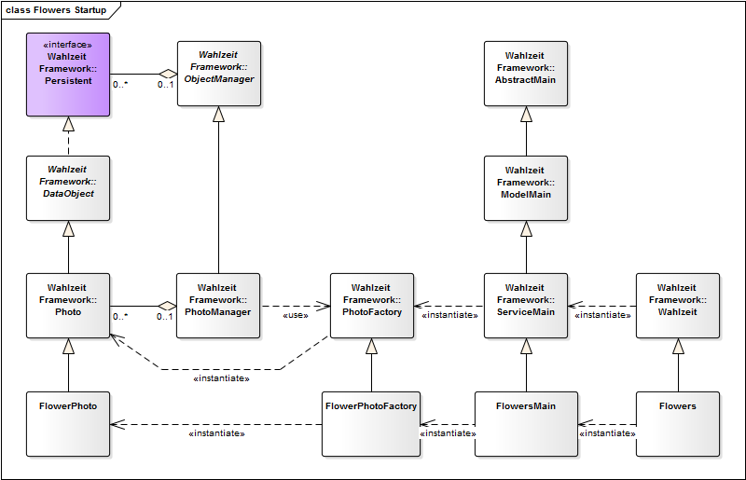
Wahlzeit Framework with Flowers Extension
Framework
Extension

Slide 23
6. Meta-Object Protocol

Slide 24
Meta-Object Protocol
Java annotations

Slide 25
7. Tiers vs. Layers

Slide 26
Tiers of Runtime Components
Presentation
Domain Model
Database
Interest
Calculator
0..n
1
Savings
Account
Business
UIWidget
0..n
1
Business
Object
1
1
Data
Holder
0..n
1
UIWidget
ModelObject
Object

Slide 27
Layers of Code Components
Application
Interest
Calculator
0..n
1
Savings
Account
Framework
Business
UIWidget
0..n
1
Business
Object
1
1
Data
Holder
Platform
0..n
1
UIWidget
ModelObject
Object

Slide 28
Tiers vs. Layers (Riehle’s Definition)
Tiers and layers are both stacking mechanisms
  Higher-level stack elements can only call / depend on lower-level elements
  Explicit calls go from higher to lower element, never the other way
  Control flow returns to higher element implicitly after a method call ends
  Strict stacking allows only for dependencies on the next lower level
Tiers are stacks of runtime components (object aggregations)
  There can be multiple runtime components in one tier
  Higher tiers use callbacks to receive control flow from lower tiers
  Tiers are primarily drawn left-to-right
Layers are stacks of code components (class aggregations)
  There can be multiple code components in one layer
  Higher layers use inheritance to receive control flow from lower layers
  Layers are usually drawn top-to-bottom

Slide 29
Summary
Components
Object oriented frameworks
Use-client interface
Inheritance interface
Framework extensions
Meta-object protocol
Tiers vs. layers

Slide 30
Thank you! Questions?
dirk.riehle@fau.de – https://oss.cs.fau.de
dirk@riehle.org – https://dirkriehle.com – @dirkriehle
DR

Slide 31
Legal Notices
License
  Licensed under the CC BY 4.0 International License
Copyright
  © 2012-2022 Dirk Riehle, some rights reserved

